Slide 1
A Presentation on RS-232

Slide 2
What is RS-232?
RS-232 is a standard by which two serial devices communi cate with each other.
RS stands for Recommended Standard 232
The connection must be no longer than 50 feet .
Transmission voltages are -15v and +15v.
It is designed around transmission of characters(of 7 bits of length).
Current version is TIA RS-232-F,introduced in 1997.

Slide 3
Logical voltage
Logical 1 is -15v.
Logical 0 is +15v.
When the connection is idle the hardware ties the connection to logical 1

Slide 4
Standard
In RS-232,user data is sent as a time series of bits.
RS-232 devices may be classified as Data Terminal Equipment (DTE) or Data Communication Equipment s(DCE).
DTE refers to terminals and computers that sends and receives data.
DCE refers to communication equipment as modems that are responsible for data transferring.
Max data rate is 20kb/s at max length.

Slide 5
How to transmit data?
RS -232 , communication is dependent on a set timing speed at which both pieces of hardware communicate . In other words the hardware knows how long a bit should be high or low.
RS-232 specifies the use of start and stop bits.
Every time a character is sent , the same communication occurs:
Start bit sent.
Seven data bit sent.
Stop bit sent.

Slide 6
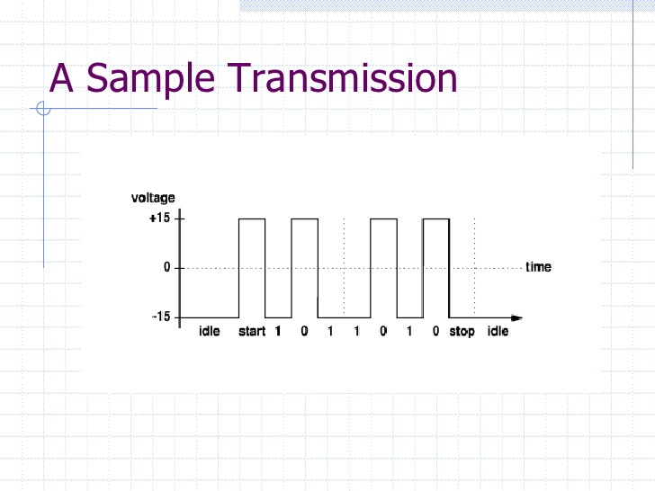

Slide 7
Limitation
The limited transmission speed relatively large voltage swing and large standard connectors motivated development of the USB .
The connection can only be maximum of 50 feet.
Multi-drop connection among more than two devices is not defined.
No multi point capability.

Slide 8
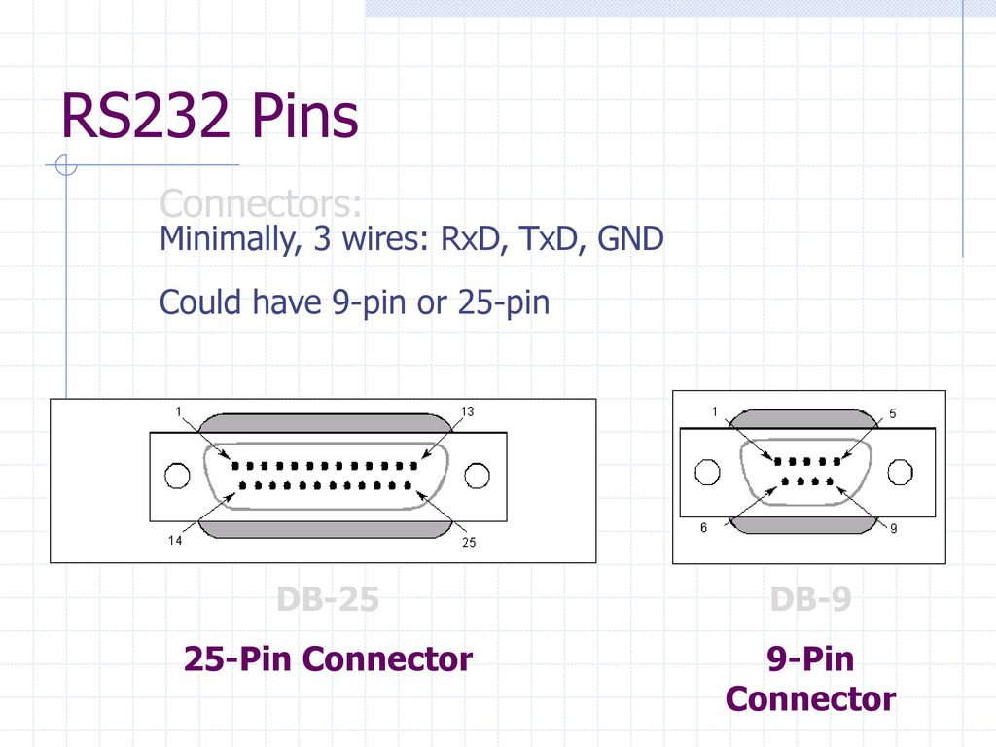

Slide 9
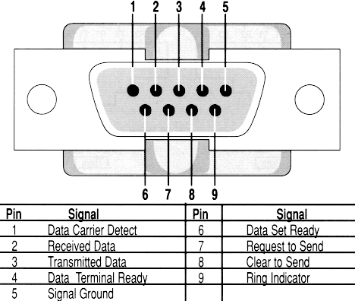

Slide 10
THANK YOU!!!

